Slide 1

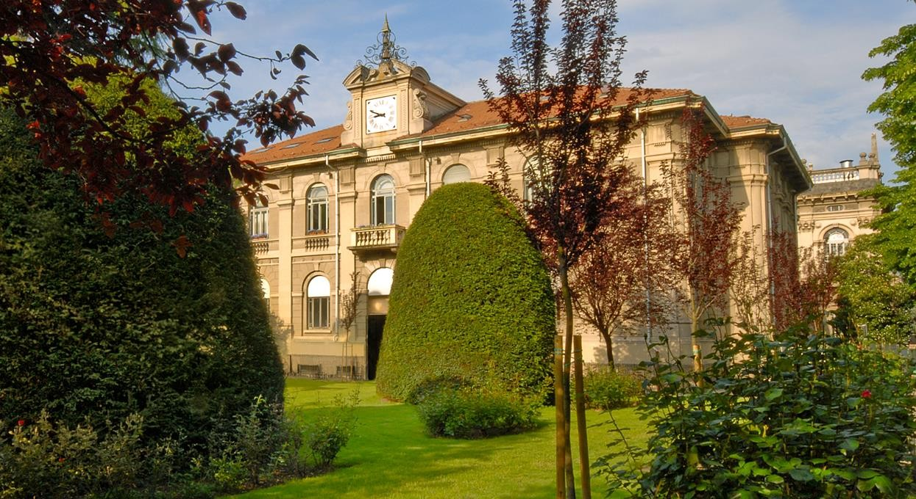

Earth Observation
Assessing Burn Severity Indexes for
Fire Mapping
using Mulstispectral Satellite Imagery
Lorenzo Carlassara 10601118
2022/2023

Slide 2

https://www.researchgate.net/figure/Comparison-of-the-spectral-response-of-healthy-vegetation-and-burned-areas-Source-USDA_fig4_359705541

Slide 3
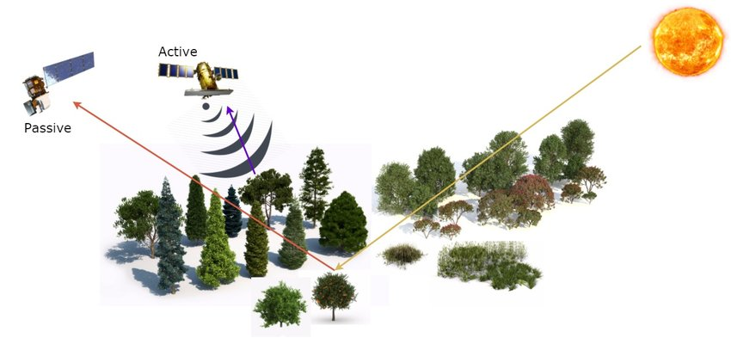
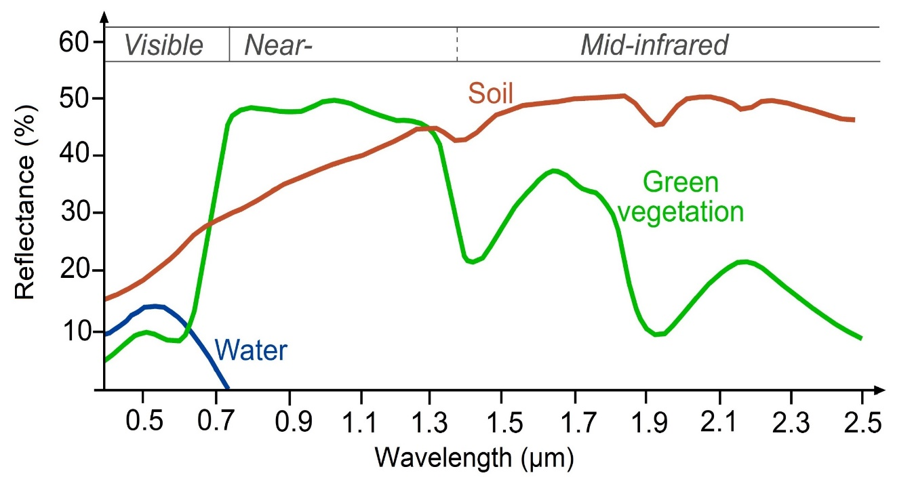
Multispectral Satellite
Spectral signature
https://www.researchgate.net/figure/Remote-sensing-from-satellite-active-and-passive-sensors_fig1_318470938
https://www.researchgate.net/figure/Typical-spectral-signatures-of-specic-land-cover-types-in-the-VIS-and-IR-region-of-the_fig2_326405082

Slide 4
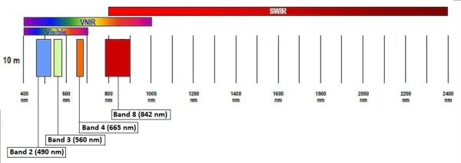
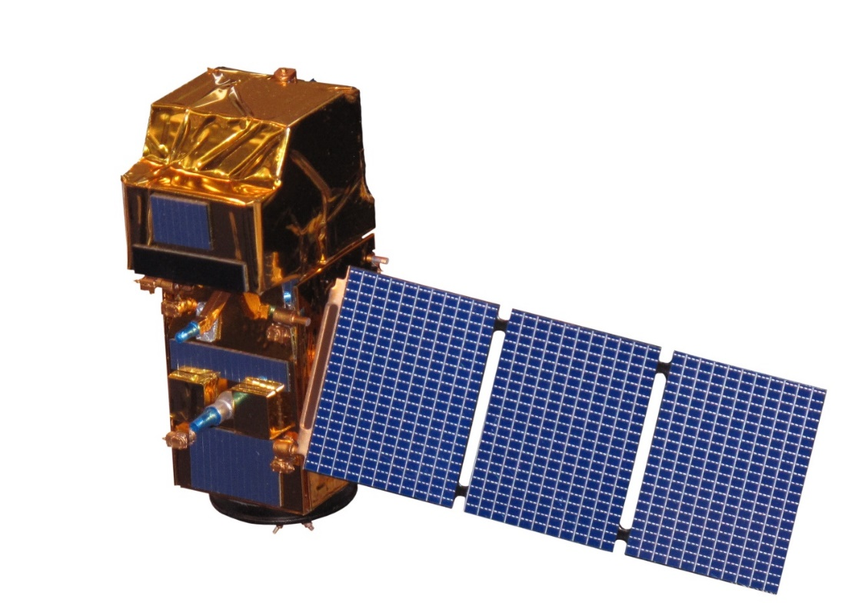
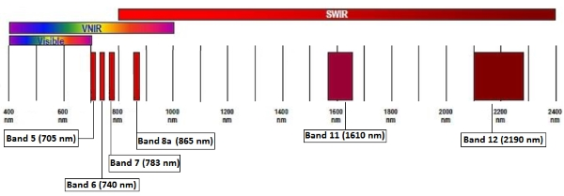
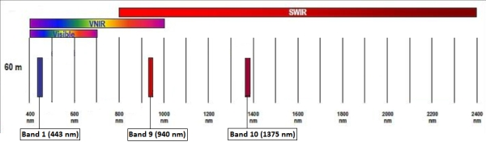
Sentinel-2 satellite
https://sentinels.copernicus.eu/web/sentinel/user-guides/sentinel-2-msi/resolutions/spatial
https://en.wikipedia.org/wiki/Sentinel-2#/media/File:Sentinel_2-IMG_5873-white_(crop).jpg

Slide 5
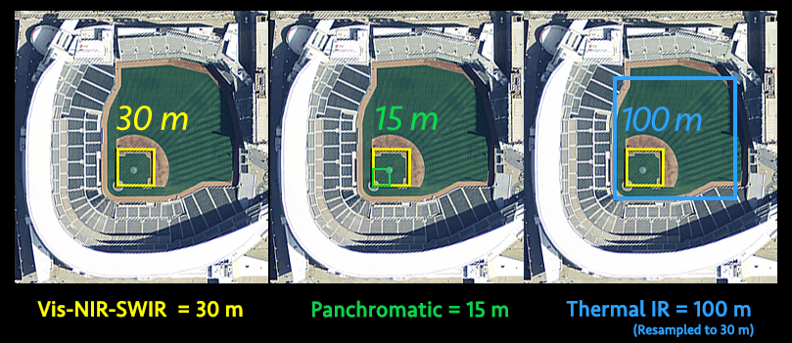
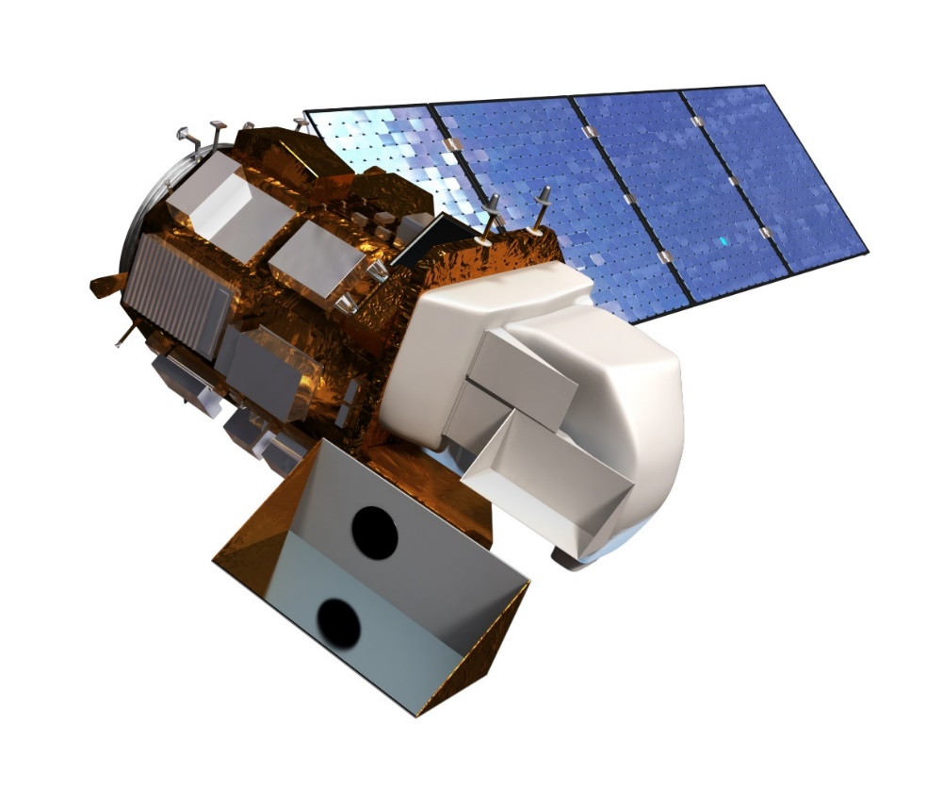
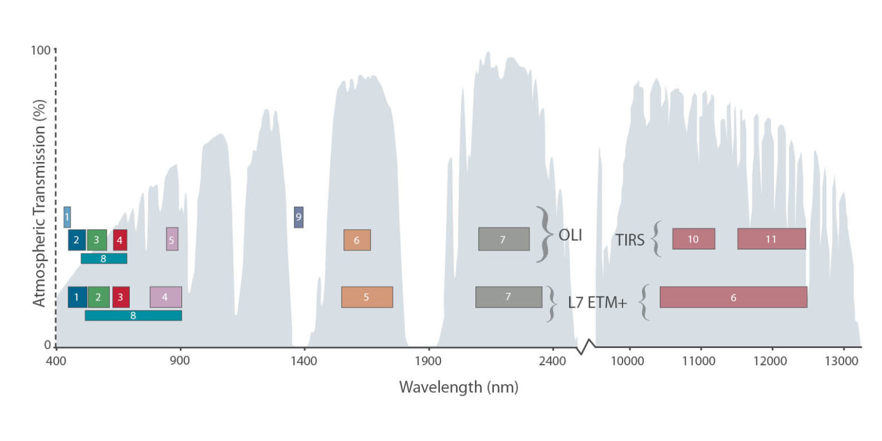
Landsat 8 satellite
https://landsat.gsfc.nasa.gov/satellites/landsat-8/
https://www.usgs.gov/media/images/landsat-8

Slide 6
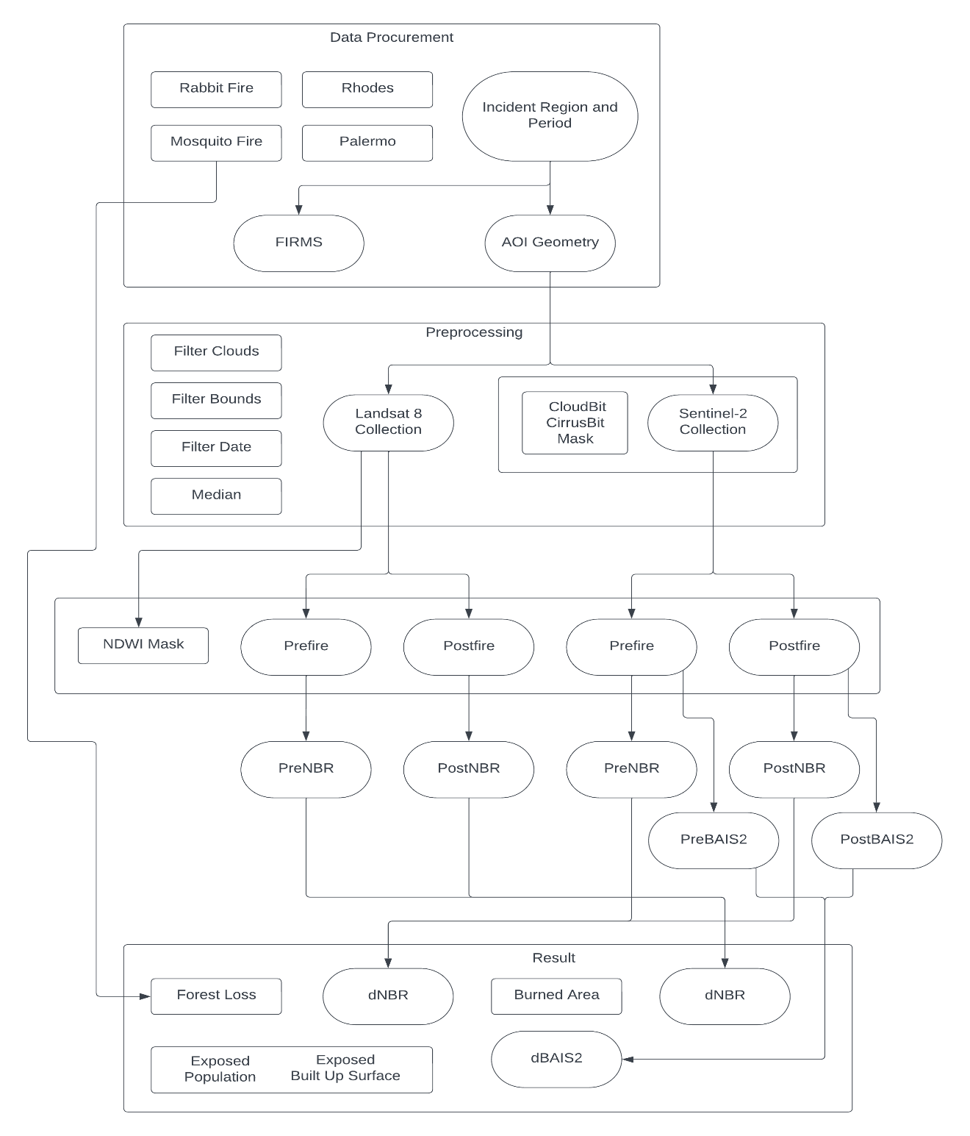
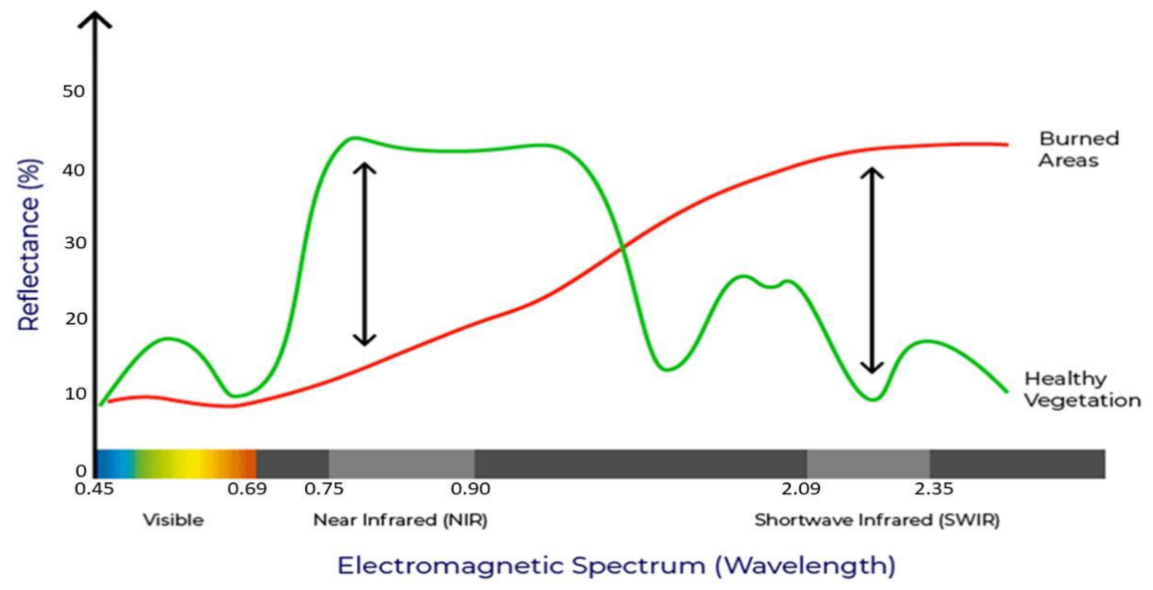
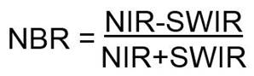
Burned Areas vs
Healty Vegetation
Spectral Signature
Workflow
Normalize Burn Ratio

Slide 7
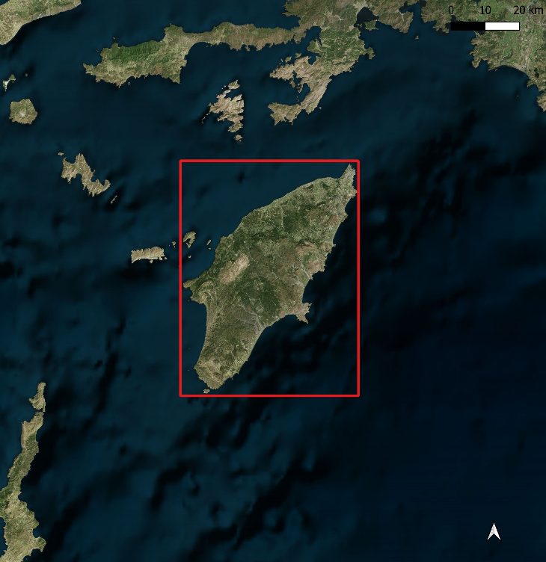
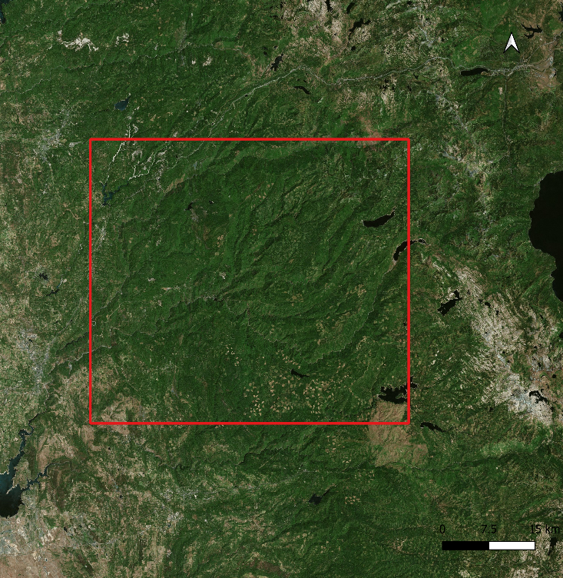
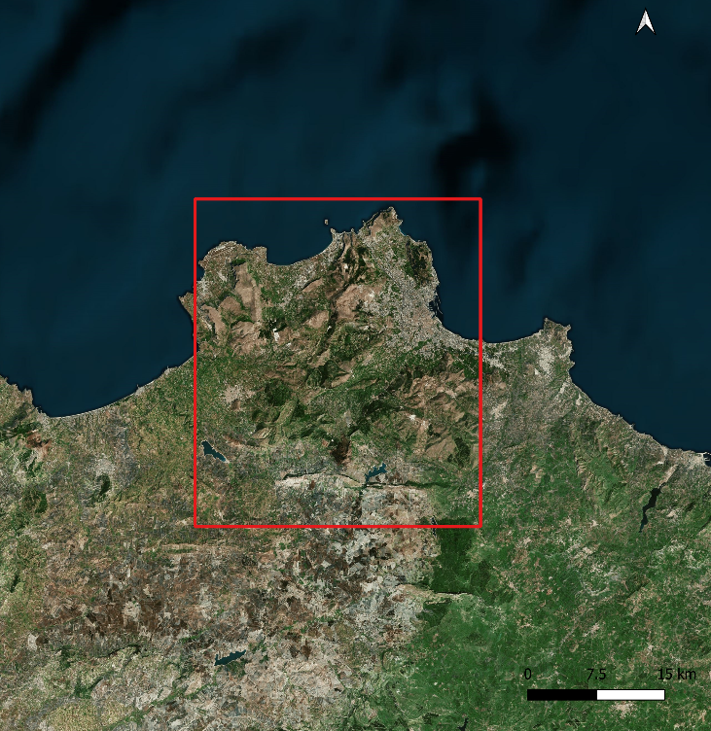
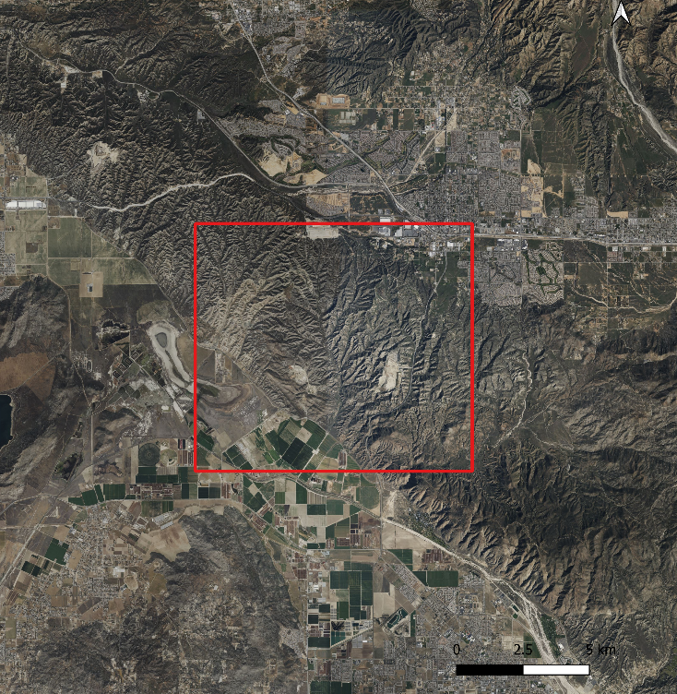
Four Fire Regions
Rhodes, GR
Mosquito Fire, CAL
Palermo, IT
Rhodes wildfires (Dodecanese, Greece)
18th July 2023 - 30th July 2023
Palermo wildfires (Sicily, Italy)
21st July 2023 - 9th August 2023
Mosquito Fire, Placer county (California, USA)
1st September 2022 - 20th September 2022
Rabbit Fire, Riverside county (California, USA)
14th July 2023 - 22nd July 2023
Rabbit Fire, CAL
CRS: WGS 84 / Pseudo-Mercator

Slide 8
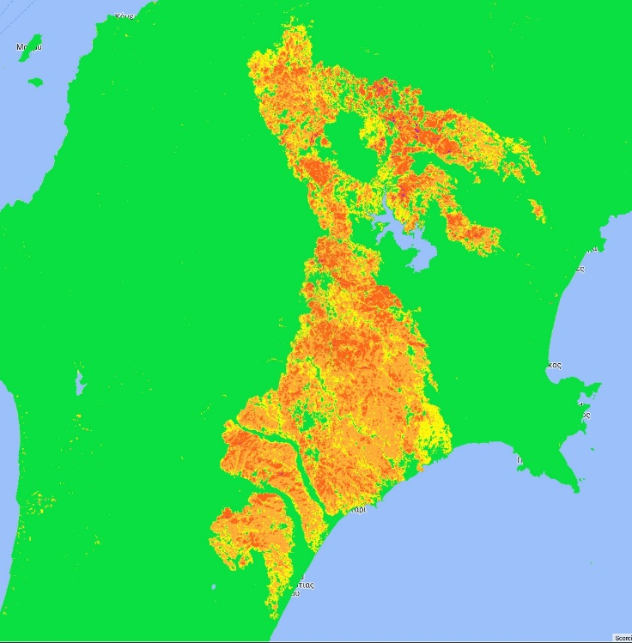
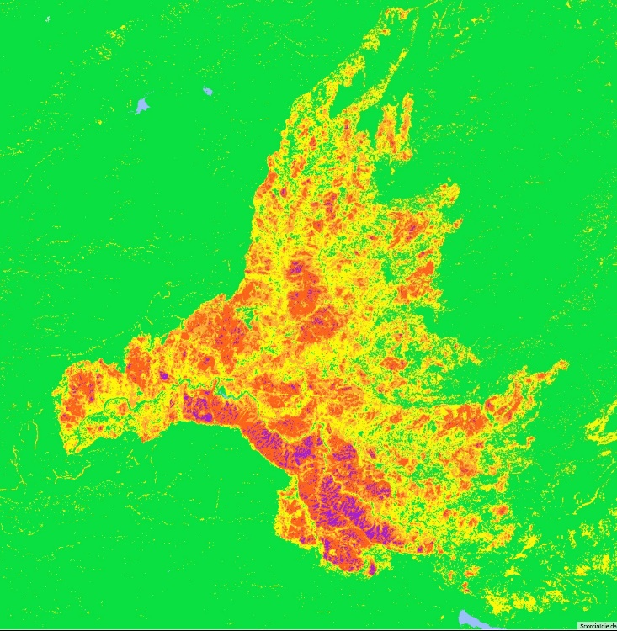
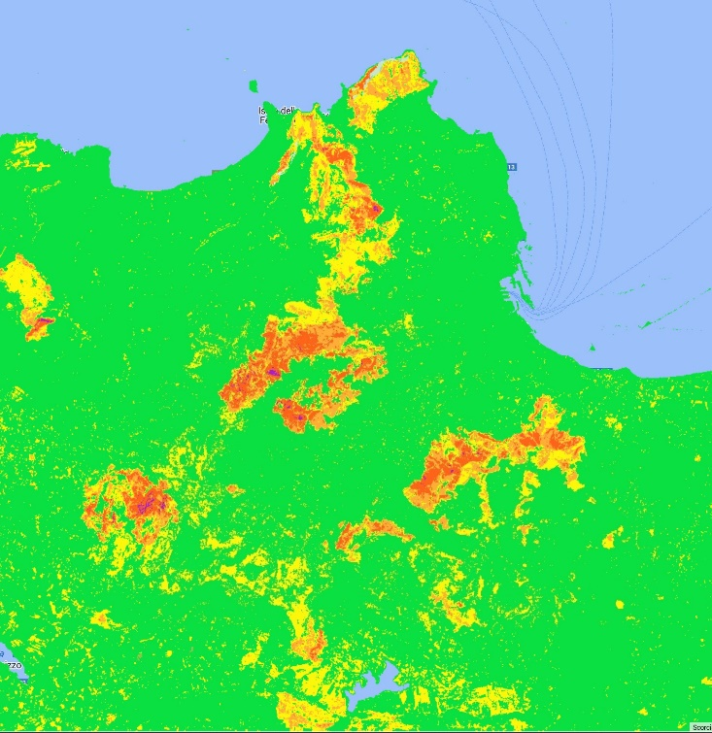
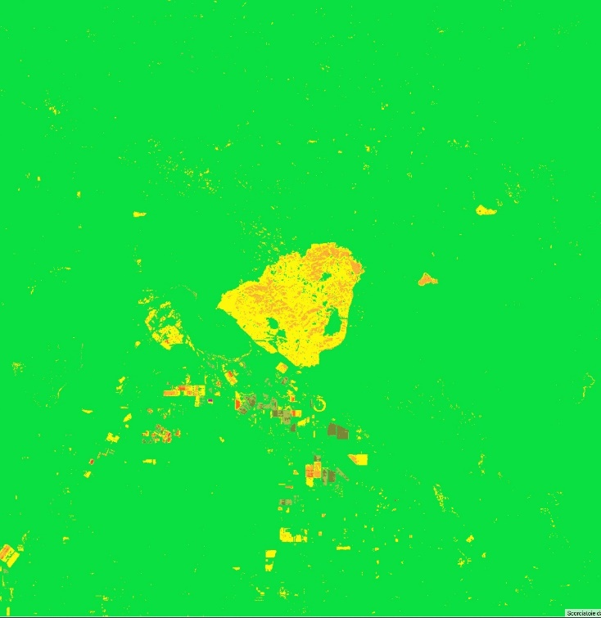
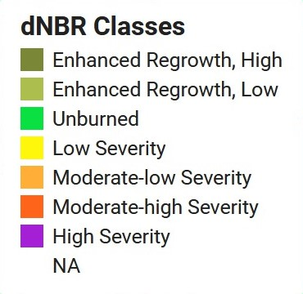
Sentinel-2

Slide 9
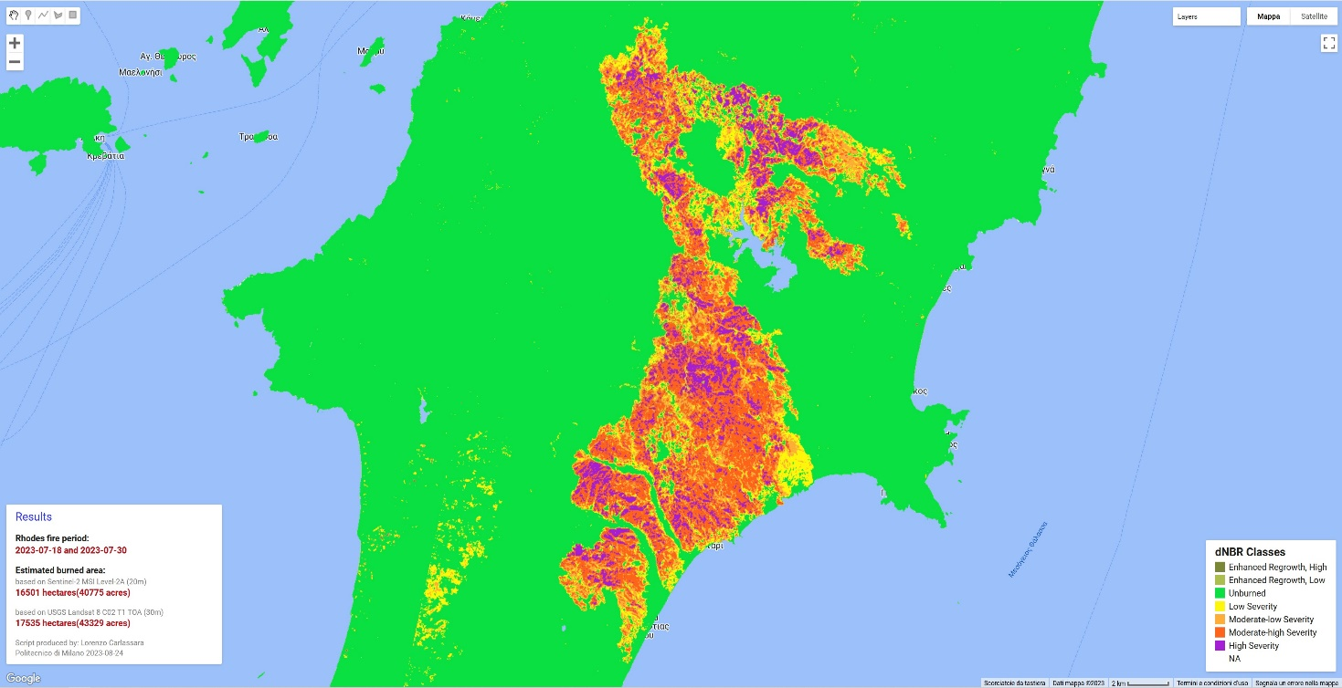
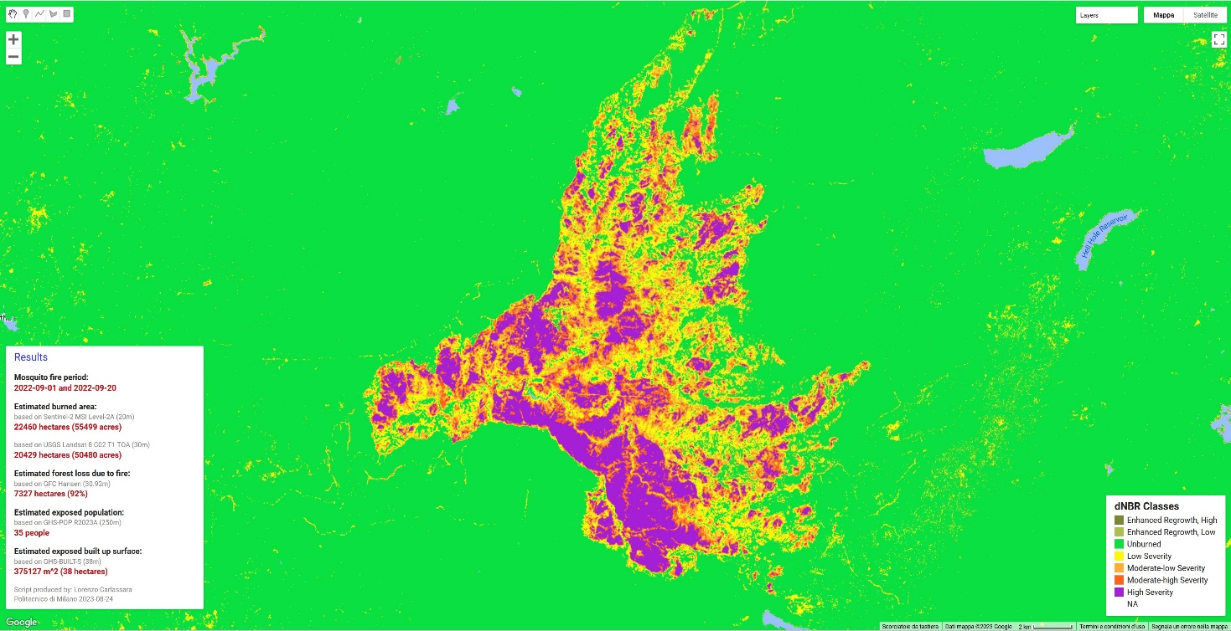
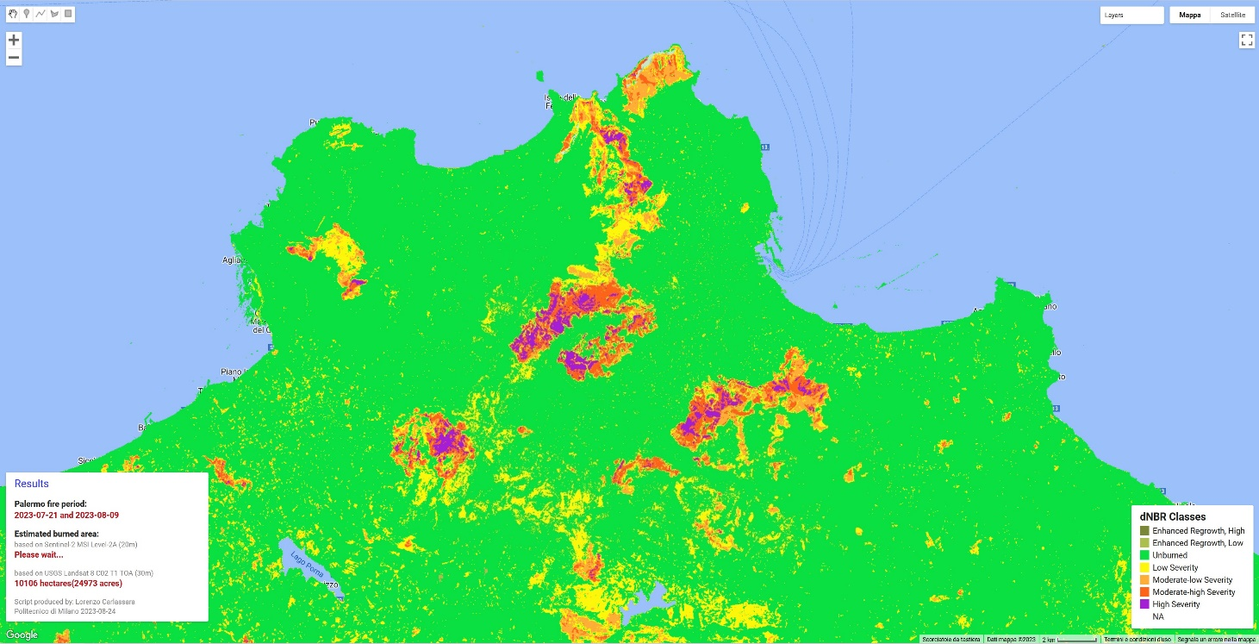
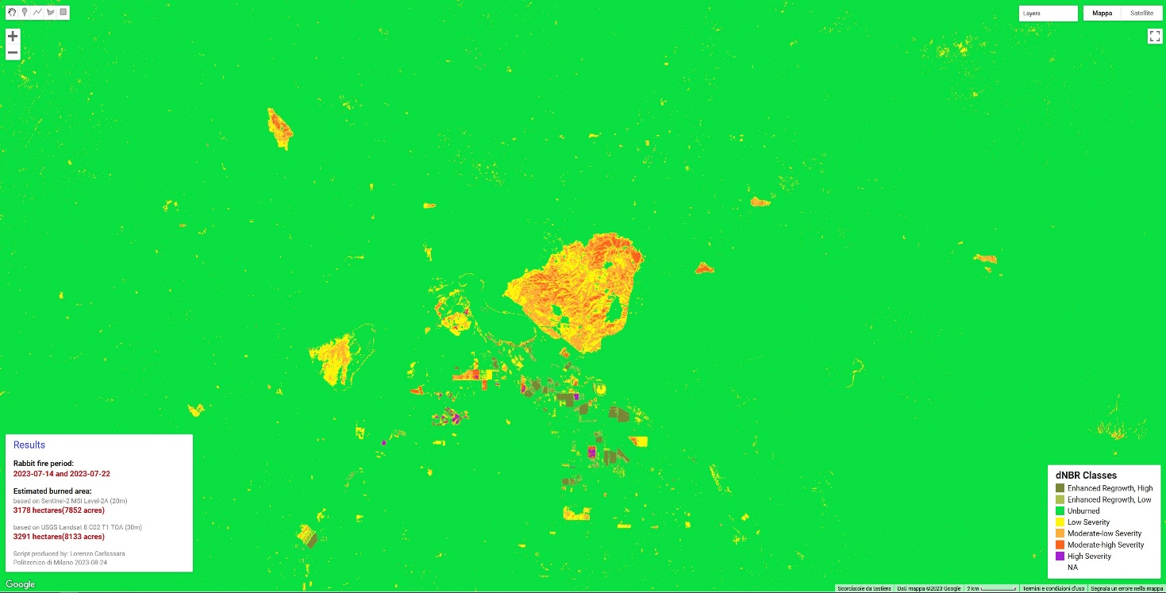
Landsat 8

Slide 10
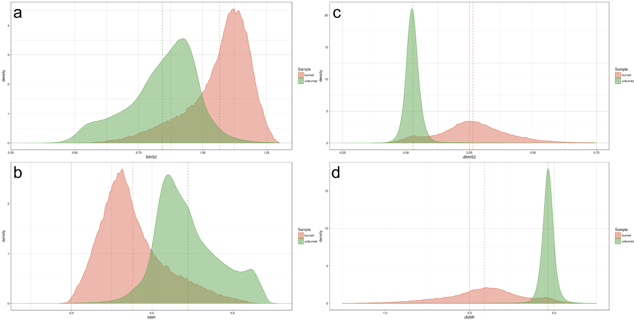
BAIS2
dBAIS2
NBR
dNBR

Slide 11
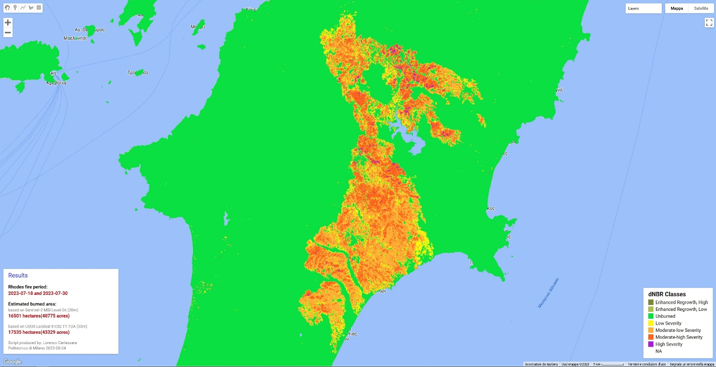
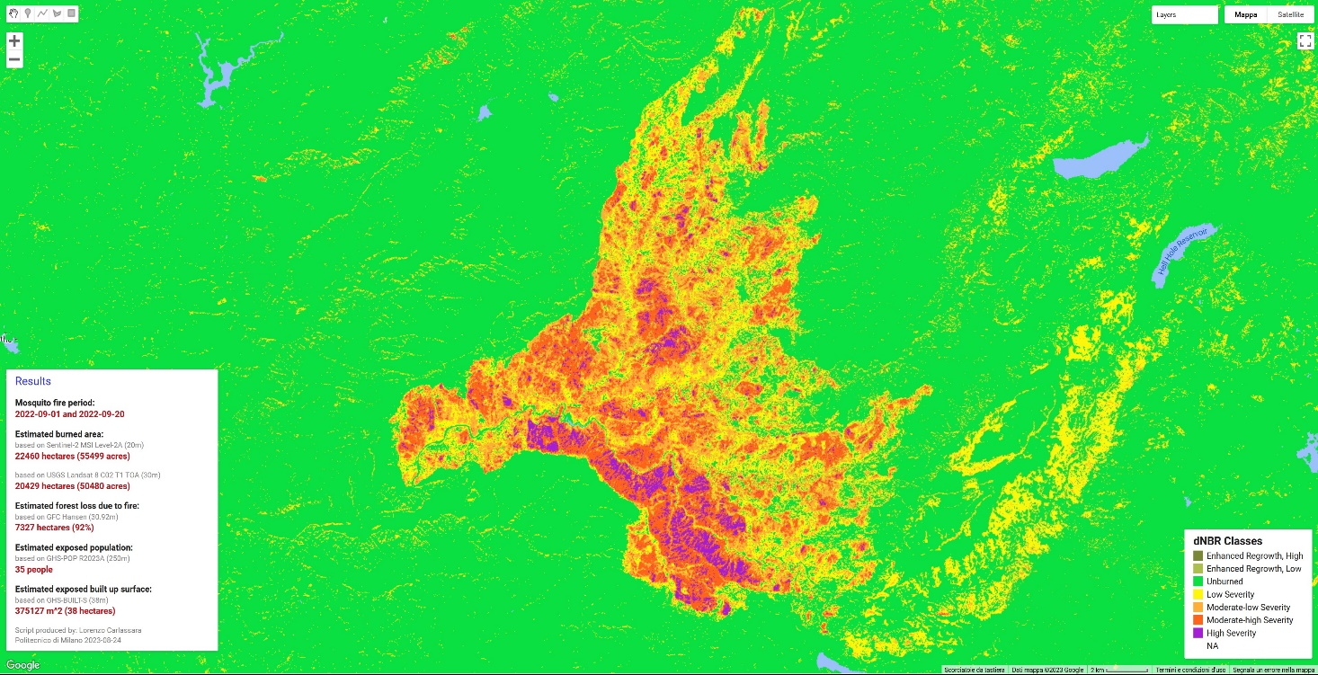
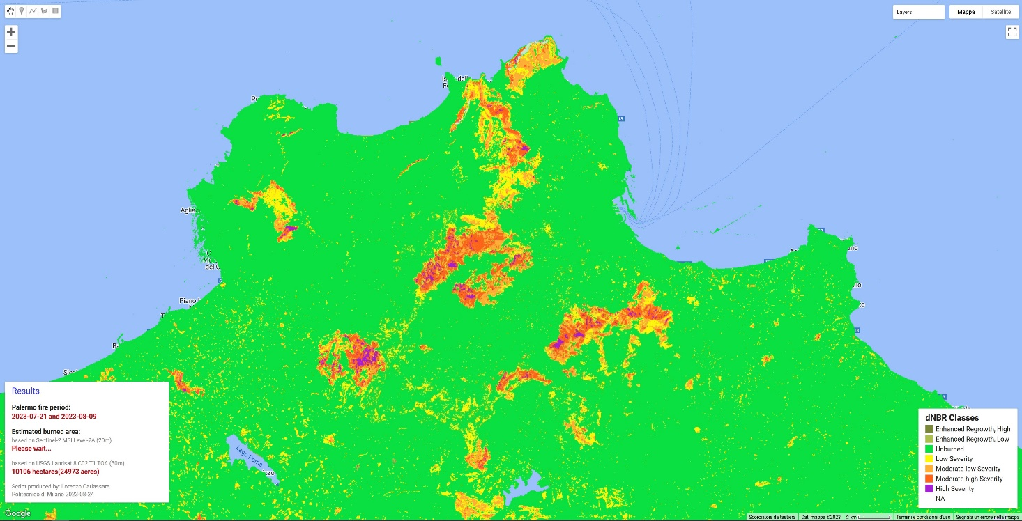
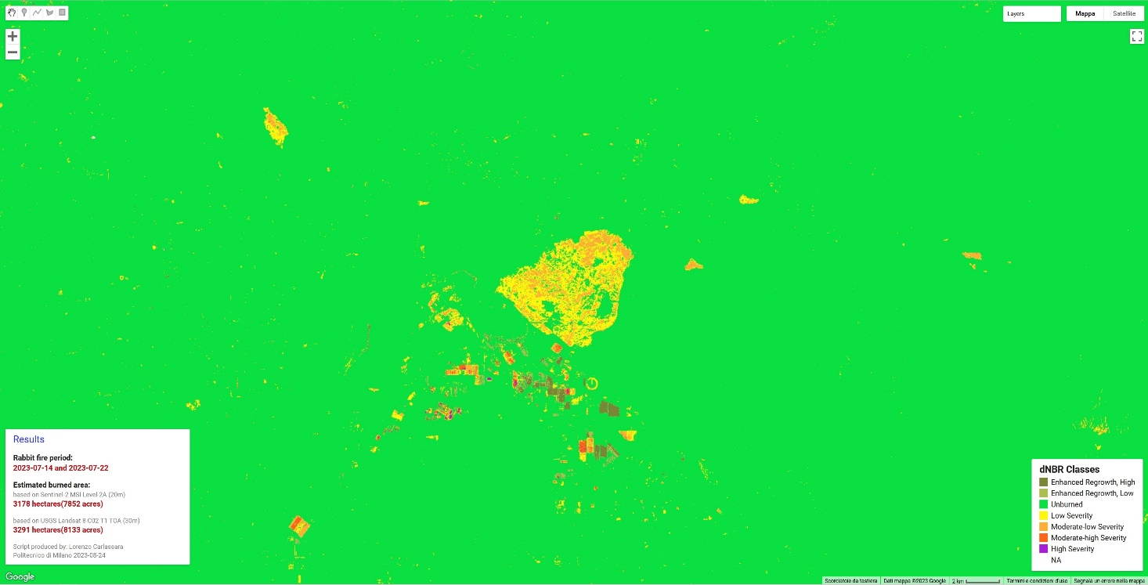
dBAIS2

Slide 12
Burned Area Detector

Slide 13
Burned Area Detector

Slide 14
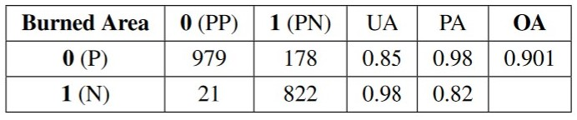
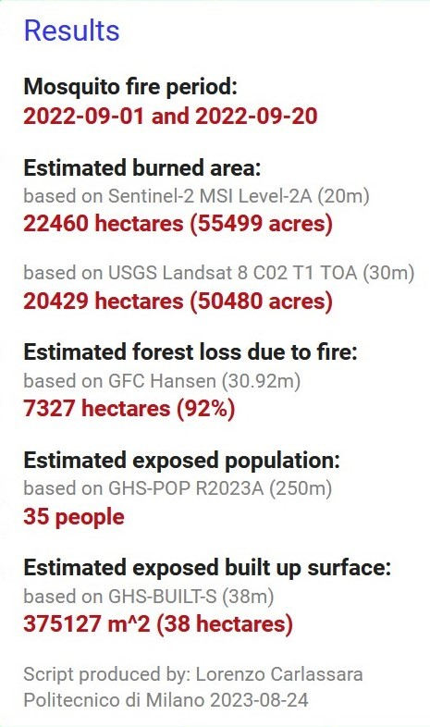
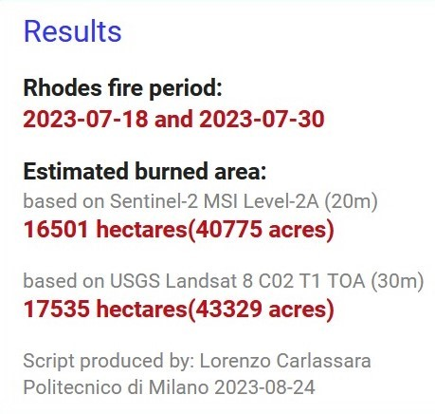
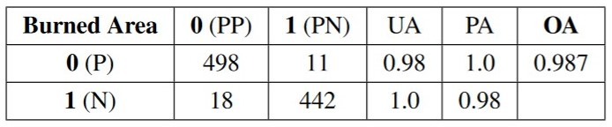
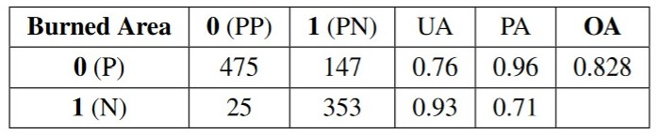
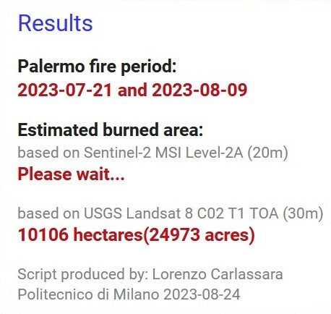
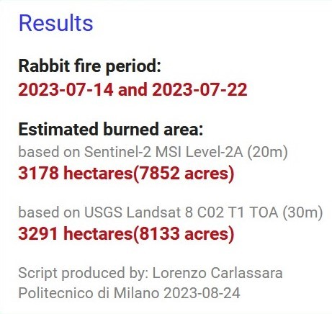
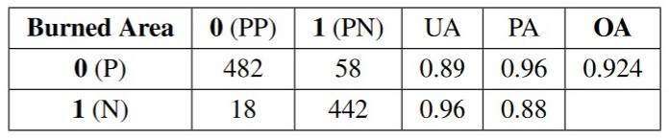
Confusion Matrices and Results

Slide 15
Thanks for your attention!
lorenzo.carlassara@mail.polimi.it
Geoinformatics Engineering
All materials in this presentation are from the public literature and internet. Use herein of copyrighted material is purely for academic purposes.

